Slide 1
New CFA Excel Content
From FEA Annual Meeting Keynote
Partial Presentation by Rob Langrick, CFAI

Slide 2
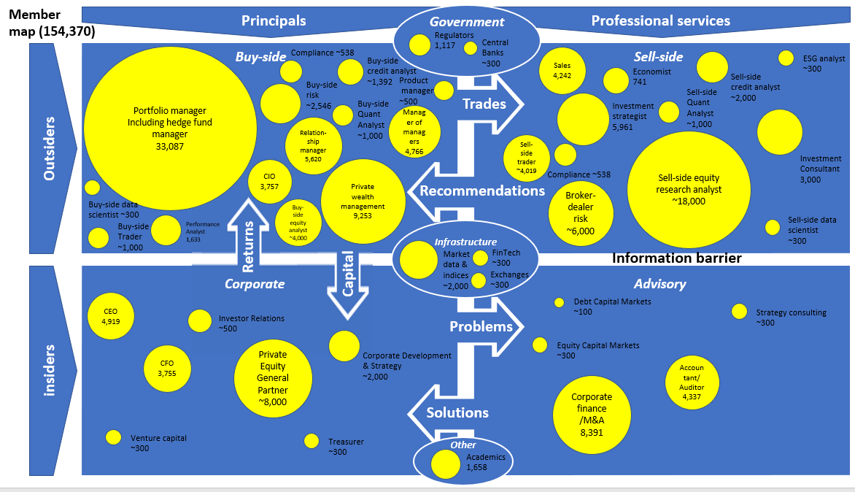
CFA Program – one of the world’s largest finance credentials - services dozens of job roles across four quadrants

Slide 3
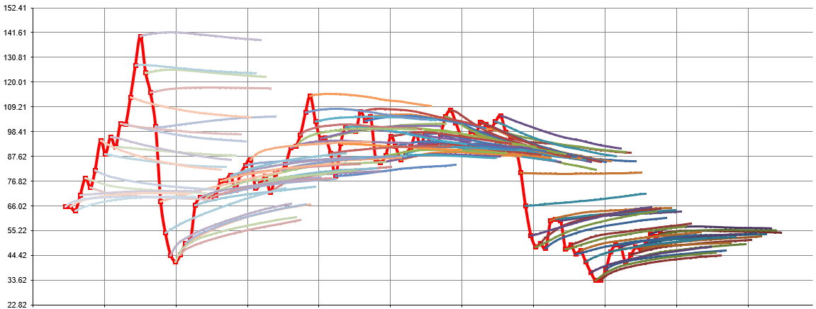
We have barely begun to weave toolkits into the curriculum itself
Junior finance professionals spend much of their professional lives in Excel - building a relatively small handful of artefacts
Charts
Monitors
ILLUSTRATIVE
Schedules
Pro-forma company accounts
Dashboards
Tearsheets
Heatmaps
Tables
Calculators
Calendars
Reports
Scenarios
Excel is “where the rubber meets the road” in most junior finance roles

Slide 4
ILLUSTRATIVE
Excel is go-to tool across key mathematical areas
 | Countries | Currencies | Companies/ Equities | Bonds | Derivatives | Funds | Portfolios | Indexes
Monitoring | -Economic indicators -Economic calendars | -Pairs matrix | -Earnings calendars -Estimates revisions | -Credit ratings -Sovereign debt monitor | -Swap monitors | -ETF flows -Mutual fund flows | -Return calculations -Performance attribution | -Addition/deletion -Composition & weights -Liquidity
Fundamental analysis | -Aggregate debt ownership | -Interest rate differentials -Hot money flows | -3 statement modeling -Ratio analysis -Merger modeling | -Term structure analysis | -Forward curve matrix | -Fund tearsheets | -Carbon footprint -Geographic & sector analysis | -Dividend forecasts -Aggregate financial statements
Risk analysis | -ESG ratings -Economic scenarios -Geopolitical analysis | -Implied volatility -Butterflies -Risk reversals | -Credit risk ratings -Default probabilities -ESG scorecards | -Curve shift scenario analysis | -Commodity supply and demand analysis | -Risk metrics/ characteristics | -Key rate duration -Covariation matrix -”Look through” analysis | -Exposures -Sector weights
Pricing | -Credit ratings | -Dealer matrix | -Deal database -Beta calculations | -Matrix pricing | -Option pricing | -NAV reports | -Portfolio P&L | -Weighting methodology
Valuation | -Sovereign spreads | -PPP analysis -REER/NEER | -Comps tables -DCF valuation | -Comparable analysis -Spread history | -Spaghetti diagram -Swap valuations | -Public market equivalents analysis | -Characteristics analysis | -Relative valuation -Comps tables
Idea generation | -Central bank watching | -Forward discount rates -Pairs trades | -Valuation screens -Merger arbitrage -Technical analysis screens | -Rich v cheap analysis | -Multi-leg strategies -Roll strategies -Implied vol | -Attribution/ contribution analysis -Style analysis | -Performance optimization -What-if analysis | -Year-end target prices ranges

Slide 5
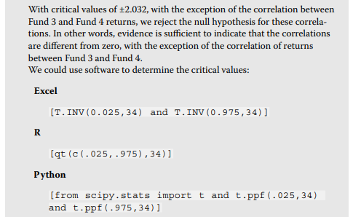
CFA Program contains Excel “snippets” throughout, weaving in relevant Excel functions; learn finance & learn Excel
ILLUSTRATIVE
Companies/Equities
XNPV: NPV for schedule of cashflows
DB: Depreciation fixed-declining balance
Bonds
EFFECT: Effective annual interest rate
MDURATION: Macaulay modified duration
Funds
XIRR: Rate of return for schedule of cashflows
PERCENTILE: K-th percentile of values
Portfolios
COVAR: Covariance
SLOPE: Slope of a linear regression
Indexes
GEOMEAN: Geometric mean
CORREL: Correlation coefficient
Derivatives
SKEW: Skewness
KURT: Kurtosis

Slide 6
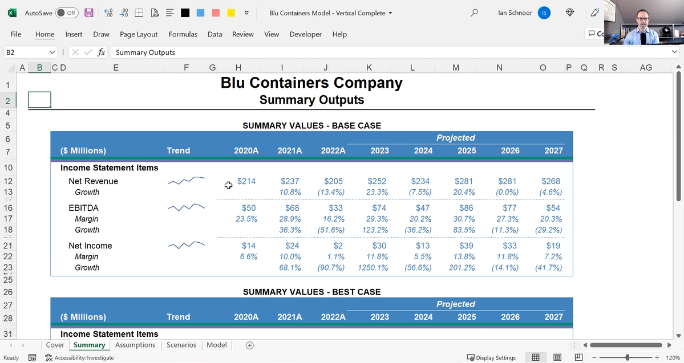
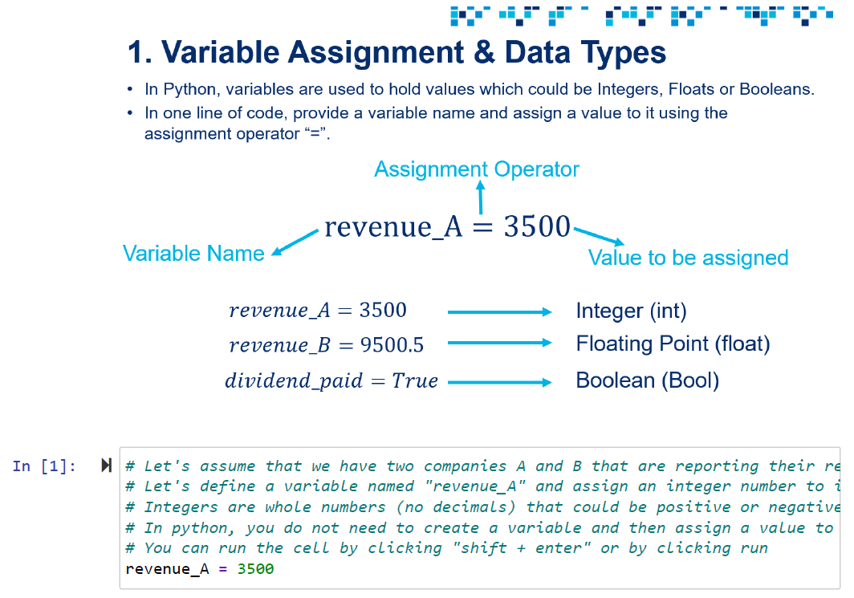
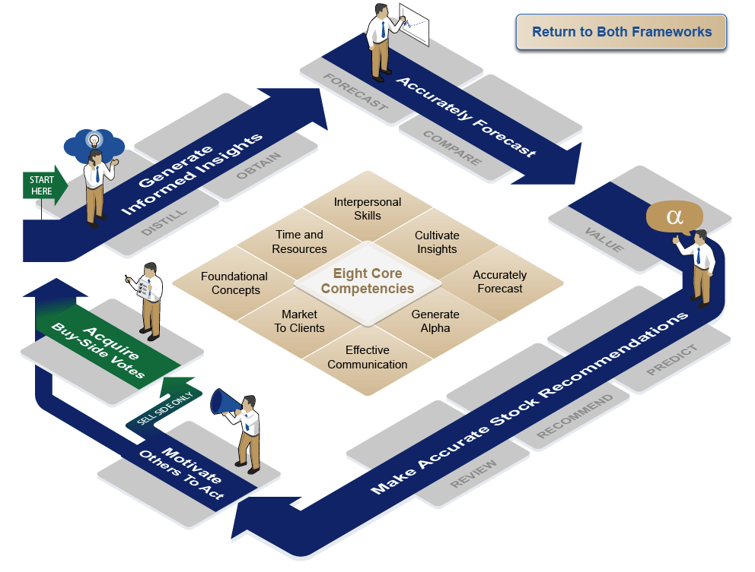
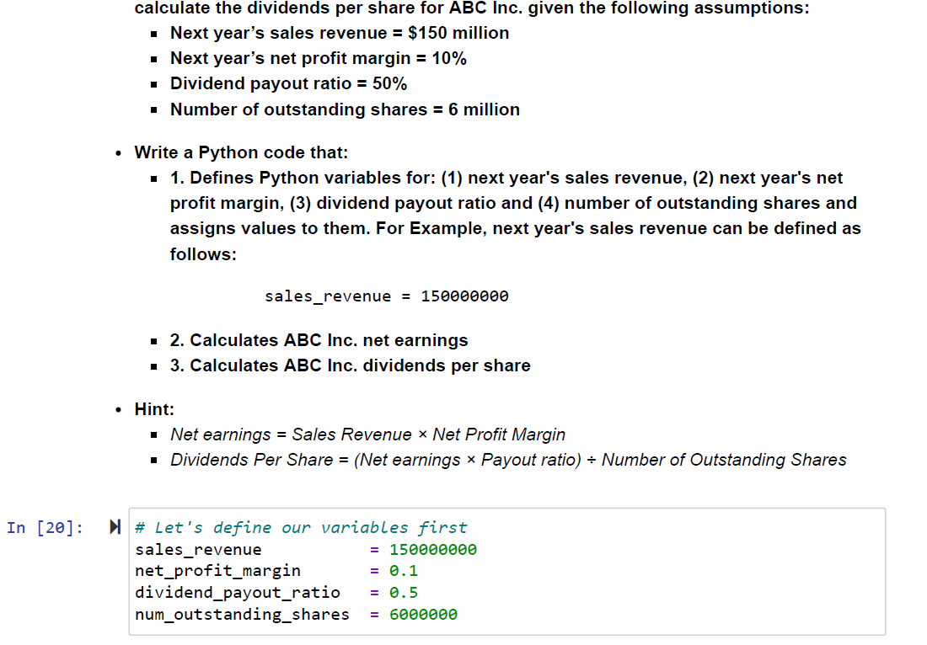
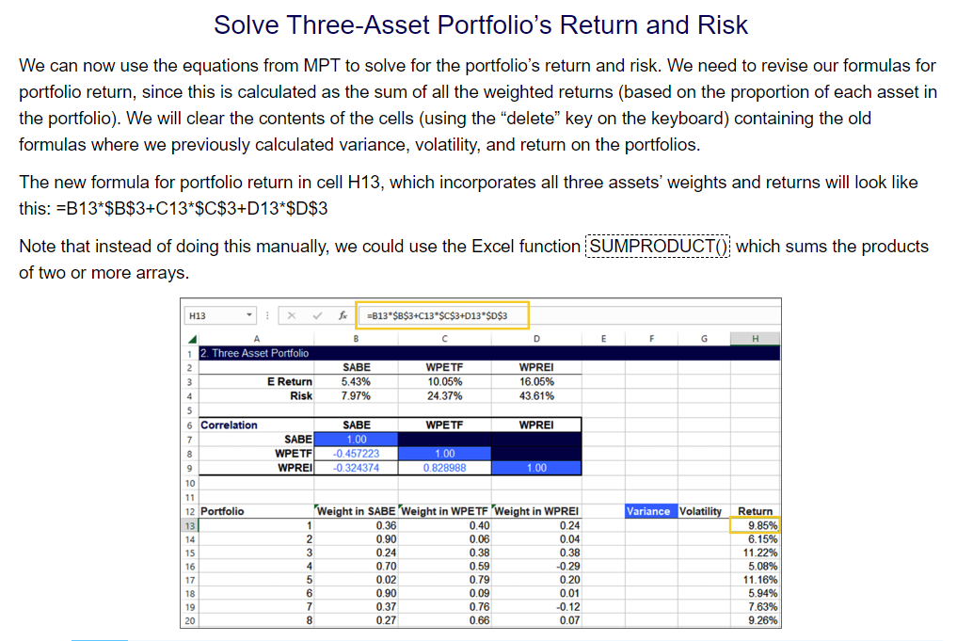
Practical Skills Modules - Topics Covered
Level I
Level II
Level III
Financial Modeling
Revenues
Costs
Depreciation
Income Tax
Working Capital
Capital Structure
Financial Statements
Outputs
Python Programming Fundamentals
Environmental Setup
Variables
Data Types
Comparison Operators
Conditional Statements
Loops
Functions
Pandas
Portfolio Optimization
Analyst Skills
Critical Factors of a Stock
Generating Insights
Choosing Valuation Methodology
Target Prices
Communicating Stock Calls
Time and Information Management
Python, Data Science & AI
Financial Data Scraping, Wrangling, Cleaning
Dividend Payout Predication Using Machine Learning Regression & Artificial Neural Networks
Edgar Data Ingestion & Sentiment Analysis Using AWS Comprehend and LSTM Neural Networks
Portfolio Development and Construction
Investment Policy Statement
Data Analysis
Strategic Asset Allocation
Capital Markets Expectations
Sensitivity analysis
Performance Evaluation

