Slide 1


Preparing Finance Students for Career Success
Insights from Industry and Higher Education Leaders
Brandon Eng
ExPrep CEO

Slide 2

Agenda
ExPrep Introduction
Navigating Today’s Financial Landscape
Corporate Insights
University Insights

Slide 3
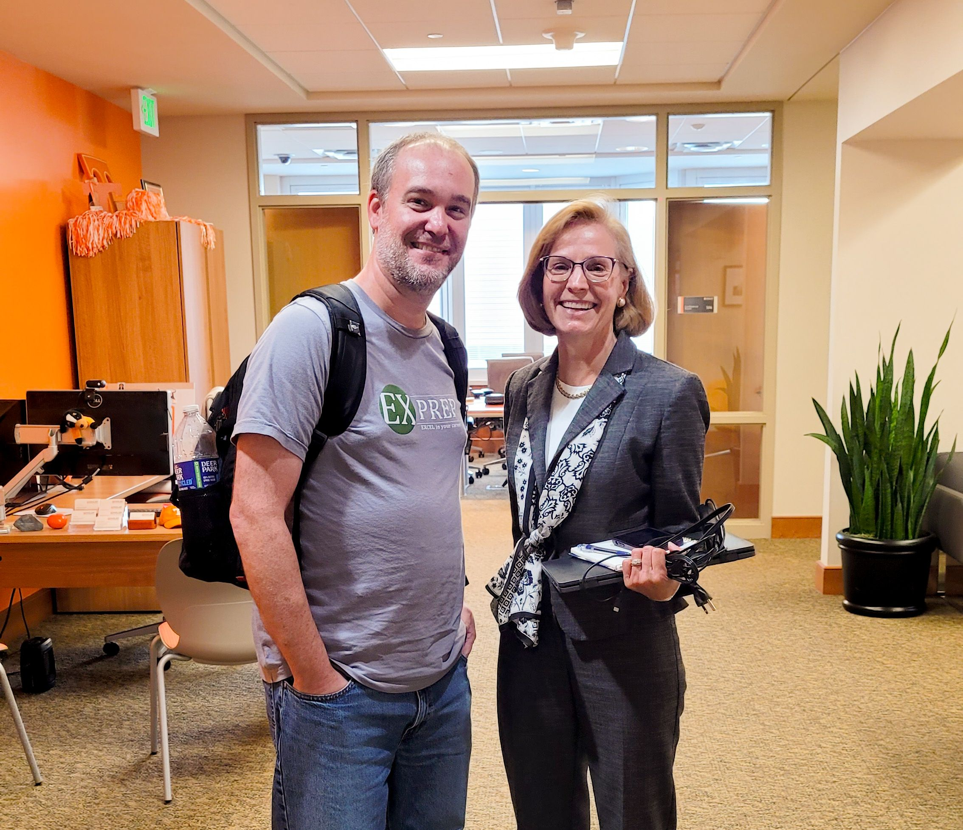
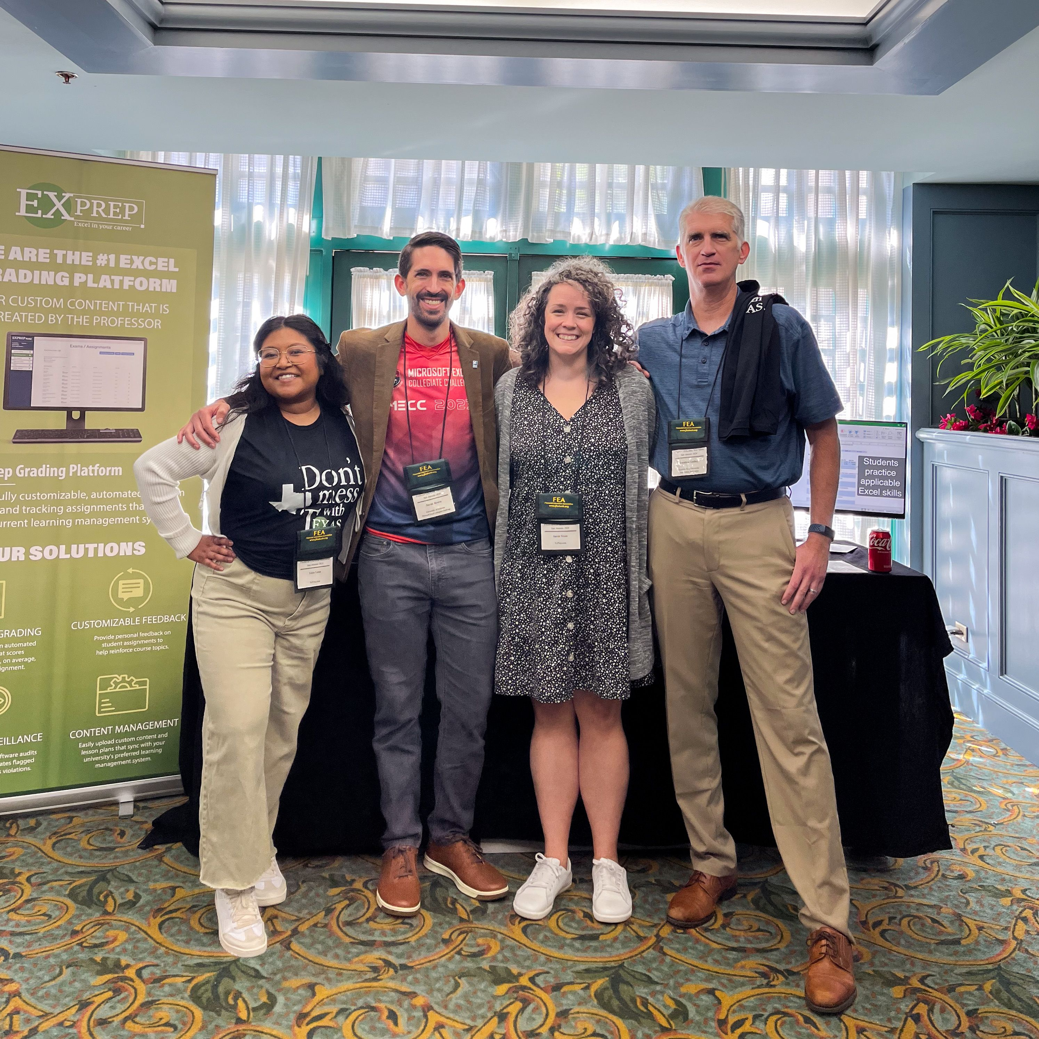
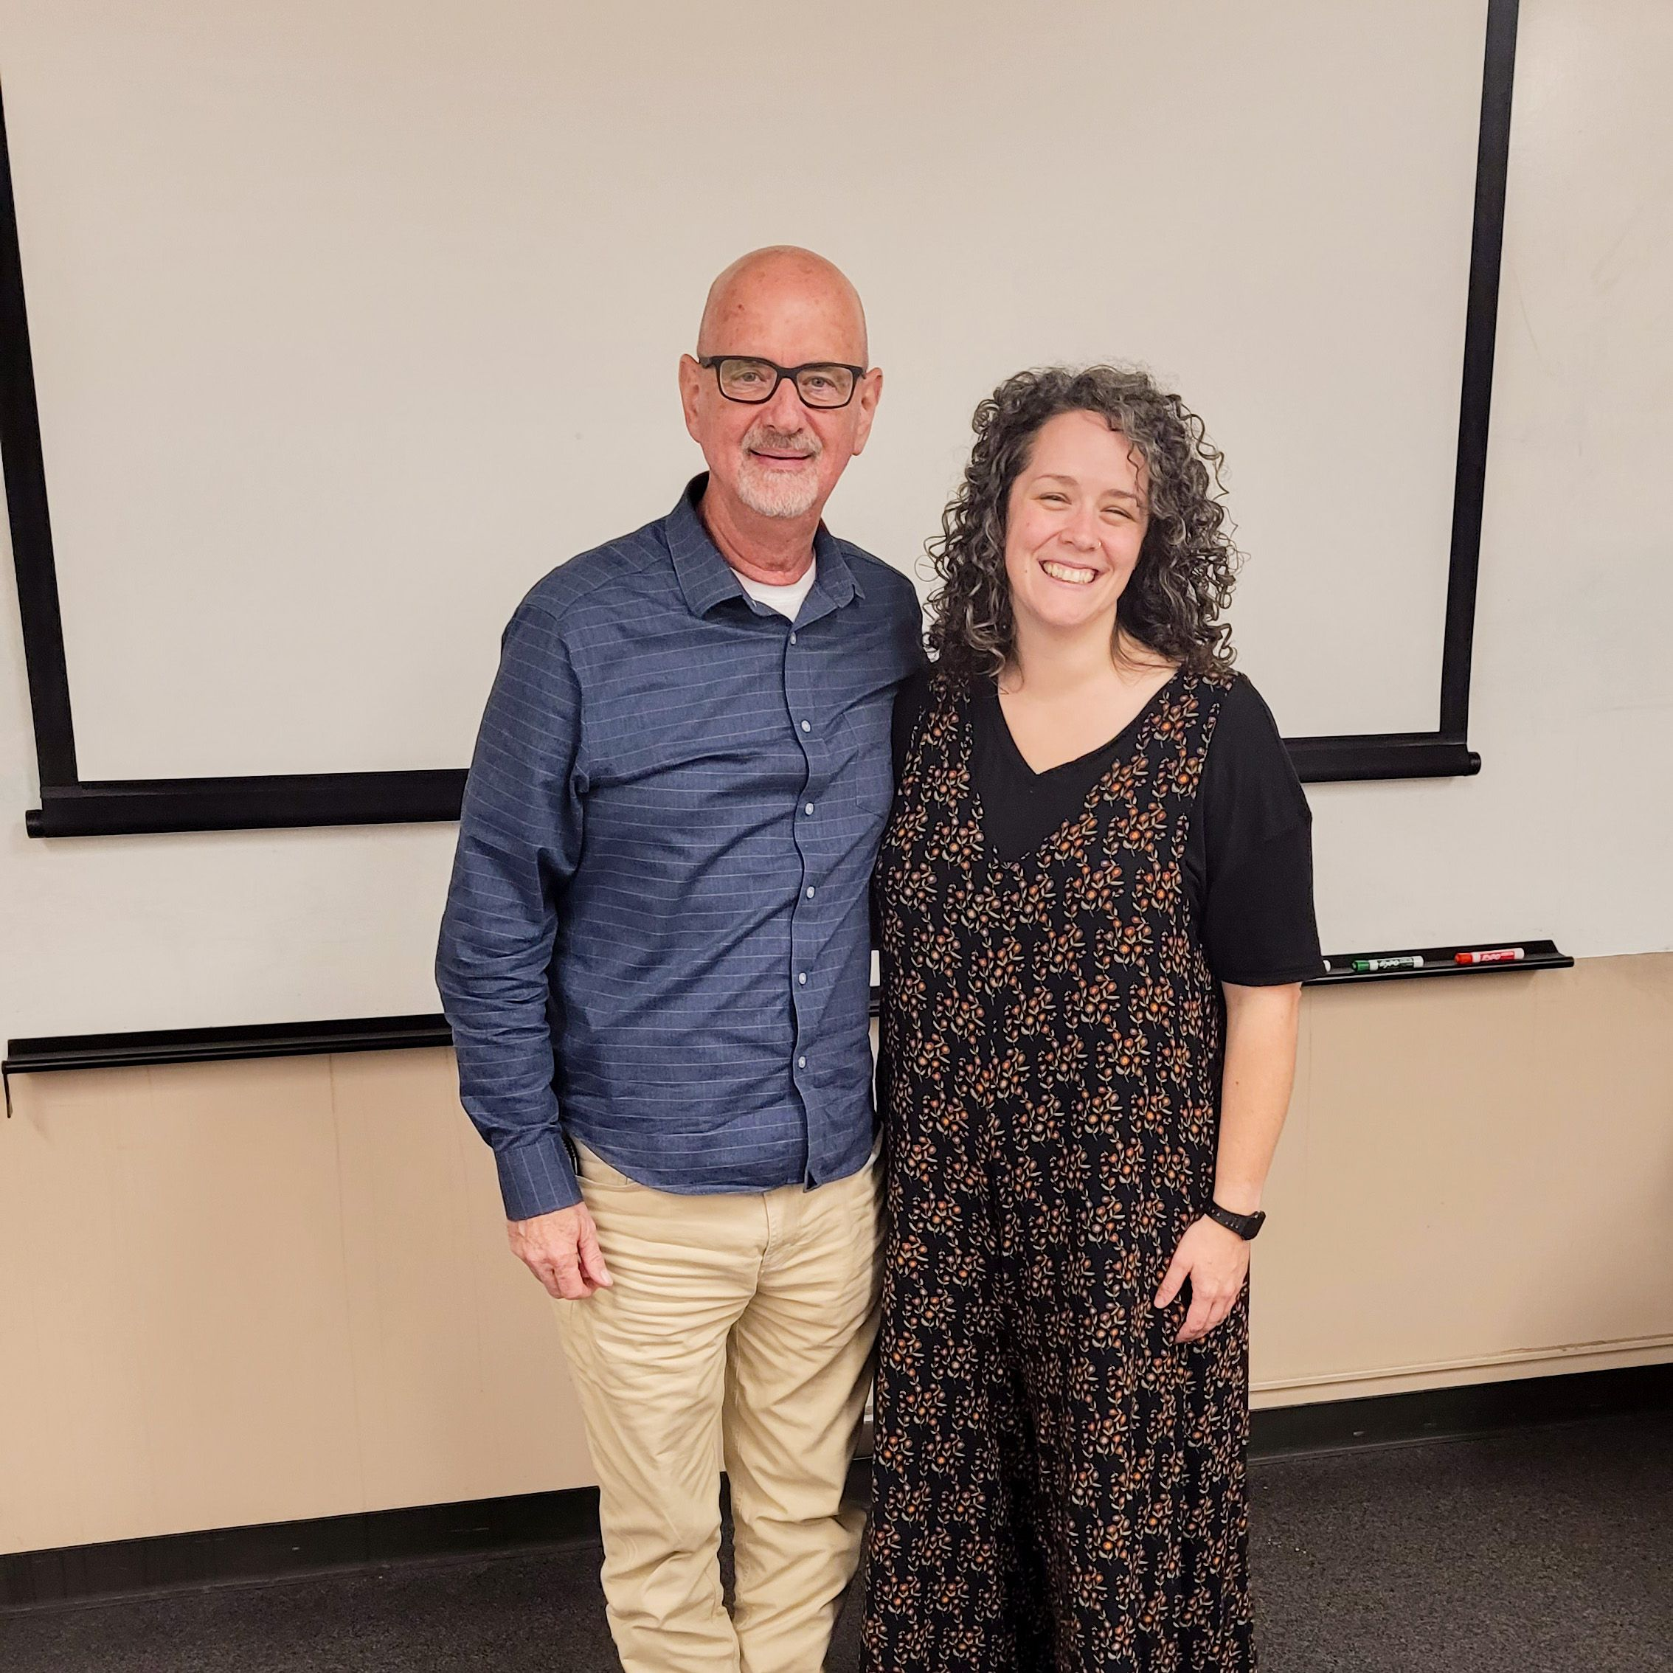
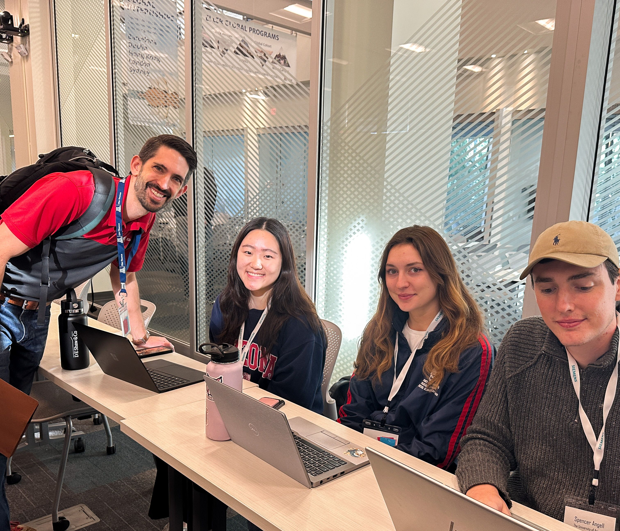
ExPrep Overview
Spreadsheet automation platform that streamlines the grading and feedback of custom content in Excel
Working with 100+ business schools around the country
Financial Partners - Training the Street, CFA Institute
Global Footprint – Private Equity, Investment Banking, etc.

Slide 4


Navigating Today’s Financial Landscape
Finance student recruitment beginning Sophomore year
AI adoption across industries
Decline in Critical Thinking, Communication, and Financial Literacy
Shift in view of Finance as a career
Notes:
Corporate firms beginning to hire for internship programs beginning Sophomore Year
Change from Junior year
Race for top talent
Students typically don’t even take finance courses until Junior year
Many students don’t even know what they want to major in
AI Adoption
AI is growing at an exponential rate
Fear that AI will replace entry-level jobs
Decline in critical thinking, social communication, and financial literacy
Finance as a career has shifted
View that Finance job like IB/PE was the job to get has become a job to get
Talent pool has diversified top talent as other big tech companies/jobs offering top pay. Still a deep pool of talent, but strong work ethic (GRIT) has become harder to find.
Decrease in Accounting majors

Slide 5

Corporate Insights

Slide 6
Corporate Institutions using AI
Integrated in Recruiting/Hiring – Suited, HireVue, etc.
AI Companions -
Building Financial Models
Delivering Insights
Not replacing jobs today, but increasing task efficiency
Notes:
Finance companies have been incorporating AI across their company in many ways
Recruiting – They are using software, including Suited/HireVue
Checks critical thinking similar to IQ tests
Uses AI to analyze video recordings and answers
Checks body language, eye contact, and communication
Recruiters typically watch videos of employees as well
AI Companions
Automate the build-out of Financial models
One of the largest Private Equity firms has an AI companion where you can run Sims that will automatically build out models
Still need to be able to read, interpret, and provide insights on models.
The big questions… Is AI replacing finance jobs today?
As of today, it doesn’t seem so. AI is still unable to consistently and accurately build full models. It helps to complete tasks quickly, but you still need to know what to do. Core concepts are still important as ever!
Critical thinking and understanding core concepts will be incredibly important for jobs in the world of AI

Slide 7

Recruiter Requirements
GPA – Reflecting work ethic
Clubs / Involvement – Leadership positions
Experience – Internships
Notes:
GPA – They look at GPA as a reflection of work ethic and ability to prioritize your workload
Recruiters seem to find that more students these days lacking in work ethic
Clubs / Involvement –
Many look for Finance clubs specifically that students are a part of
They also want some level of leadership in any type of club.
Experience – Internships
Internships are a huge plus. Been told that getting anything is important
Goldman Sachs had over 300K applicants for their summer program last year with only 2700 accepted
JP Morgan had almost 500K applicants and 4000 accepted
Outreach on LinkedIn and message either alumni or current employees at a particular firm
Making sure they do their research on the role, why they want to work at the company and know as much as possible about the company itself

Slide 8


Soft vs. Hard Skills
Soft Skills
Eye Contact / Body Language
Communication
Critical Thinking
Attention to Detail
Hard Skills
Technical - Microsoft Excel / Python / PowerPoint
Core Concepts – Read/Interpret Financial Statement
Notes:
The soft skills listed below have become an increasing concern as the next generation enters the workplace
Technology has led to increases in communication, eye contact
They’re using AI, as mentioned previously, to see if they’re able to maintain proper body language AND proper etiquette, such as how to dress
Example: Professors saw this during COVID with students not wearing proper attire or not having their cameras on during online classes.
Critical thinking has continued to decrease in the US, and as mentioned, these software are measuring your critical thinking capabilities
Future shows that you need to be able to think critically, leverage insights to make decisions
Attention to Details
I’ve heard this across the board. For example, I was chatting with the Head of Training at Houlihan and a Sr. VP of IB at Mizuho, both said that being able to spot mistakes and do things correctly is always better than completing faster
Hard Skills
Technically, students need to know MS Excel, Python, SQL.
Ability to read, analyze, and interpret financial statements
Recruiters have told me that students are not getting enough reps/practice when they graduate from college.
Students need more exposure to building financial statements, building models, etc.

Slide 9
Microsoft Excel in Finance
Excel skills is a necessary requirement
Python collects data, but Excel provides summary/analysis
Recruiting Assessments still leveraging Excel heavily
Excel with AI tools trending upward
Notes:
Spoiler Alert – YES!
Finance Recruiters/trainers/employees saying it’s a MUST-know skill
This doesn’t seem to be changing anytime soon, and many are saying that this will be relevant at least for the next 5-10 years
Python doesn’t seem to be replacing Excel.
Python is being used more to collect data, but Excel is still being used to provide summaries and analytics
Note: Microsoft has even allowed you to begin writing Python in Excel
Larger Corporate Firms use Python more, but we see smaller shops tend to use Excel more extensively
Many firms are still testing through Excel – Modeling, etc.
Some companies have built their own Excel modeling simulations for candidates to complete, while many other firms are delivering Excel models for candidates to work through. Some even have them doing Excel models live on a call or in person
Companies are also leveraging AI in Excel, such as CoPilot in Excel. From our conversations, it seems that Excel with AI tools is trending upward.

Slide 10

Higher Education Insights

Slide 11
Weekly Webinars/Seminars for incoming high school seniors
Weekly Freshman networking events
Required Finance Career course
Finance
as a Major
Notes:
The big question: If recruiting begins in the sophomore year, how do we prepare students?
- In the past, students would officially declare their majors during their junior year of college. This would also align transfer students who took Gen-Ed courses in their freshman/sophomore year
After speaking and working with many business schools, I’ve compiled some ideas on what Higher Ed is doing…
Accepted High school seniors are invited to webinars/seminars that include different professors/alumni who will talk about different majors and careers before students even come to campus
Weekly Freshman networking events
On campus, they hold speaking events with alumni about different jobs and career paths. They use this for networking, too, where alumni will bring recruiters/colleagues on campus, too
Required Finance career courses that are 1-credit classes to help expose students to different finance paths
They learn proper etiquette, like how to dress, work on resumes, and interview prep
Students are required to read the Wall Street Journal or other financial news to keep students exposed to all things Finance
- As times are changing, higher education is adapting to position their students best for earlier recruitment.

Slide 12
Finance Curriculum Changes
Excel more broadly used across all courses
Finance courses offered earlier
Finance Groups & Clubs
Mentorships
Notes:
Higher Education is changing its curricula
Universities are including spreadsheet-based assignments and projects in all of their classes, not just finance.
We hear from both higher education and corporate firms that students need better Excel skills
Finance courses are being offered earlier
Several professors here are teaching the Financial Management / Corporate Finance introductory course. This is the first time many students are exposed to finance
Other schools have even shifted courses like Financial Modeling to their Sophomores, where they originally were taken Junior/Senior year
Finance Groups
Top Finance students who apply –Gives students more exposure and practice in Finance,
Finance Clubs – Investments club, Private Equity clubs, etc
Mentorships
Bridging the connection between alumni and current students
Some schools have Juniors/seniors mentor freshmen/Sophomores
Schools have an “Alumni Advisory Council” to help make decisions as a Finance department

Slide 13

Top Classes for Finance Majors
Financial Accounting – Language of Business
Valuation / Financial Statement Analysis – Understanding value creation
Notes:
-I asked both Finance Professors and Industry Professionals the most important classes that a Finance major should take before graduating from college…
Financial Accounting – The language of business
We have found that at some universities, Finance students are not just required to take a Financial Accounting intro class, but also required to take Intermediate Financial Accounting as a requirement
We’ve been told that if you want to be successful in banking, you need to take more Accounting courses
Valuation or Financial Statement Analysis
Need to be able to read, interpret, and analyze financial statements, especially where AI is taking us
Ultimately, students need to understand how to create value.
Key drivers in value and valuation

Slide 14
Top schools across the country embracing AI
Students assume what AI creates is correct
Students fixing models that AI builds
Teaching core concepts w/o AI before incorporating AI
Designing Content where critical thinking is applied
AI Adoption in Finance Courses
Notes:
The debate between whether to embrace or push AI into higher education:
We’ve been seeing all the top universities embracing AI in their curriculum. We believe that AI is not going anywhere.
A common question I get is how are we seeing AI being incorporated into classes?
Problem: Students assume that whatever AI is creating is true
We’ve seen on the internet of AI creating images and viral posts of things happening that didn’t actually happen
The Pope in a puffer jacket
Katy Perry at the Met Gala last year
It’s increasingly important to make sure we are double-checking what AI is providing to us
Previously talked about “Attention to Detail” being more important and the emphasis on understanding core concepts:
Some things we’ve heard professors are doing/considering:
The first half of a course, students cannot use AI so that they can focus on building a foundation before introducing AI to help them create tasks more efficiently
Have AI build out models and then have students fix models
This highlights a student’s ability to think critically and improves their “attention to detail” skills
This also reflects what students may end up doing more often in the workplace, as AI is increasingly used within financial institutions
Design content so that students need to use critical thinking and answer with insights
Some professors are adding in dummy variables/material that is not relevant to the problem. Have students think critically about what information is important and what isn’t

Slide 15
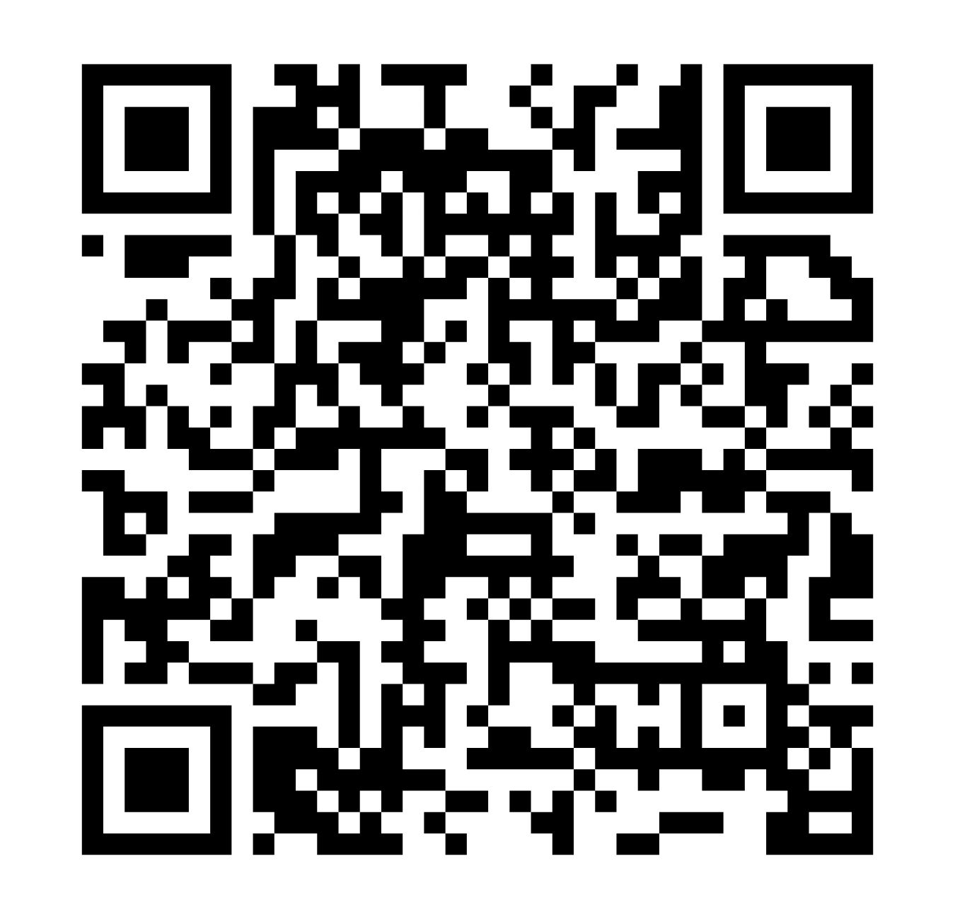
Resources for Finance Educators

